Slide 1
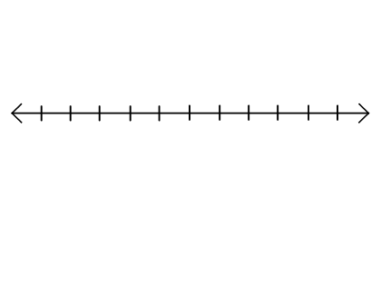
Results After 50 Rolls
2 3 4 5 6 7 8 9 10 11 12
Sum of Dice
5 Number Summary
Min. = 2, Q1 = 6, Median = 7.5, Q3 = 9, Max. = 12

